Slide 1
CableBot schematics
Pierre Margerit
20.02.25

Slide 2
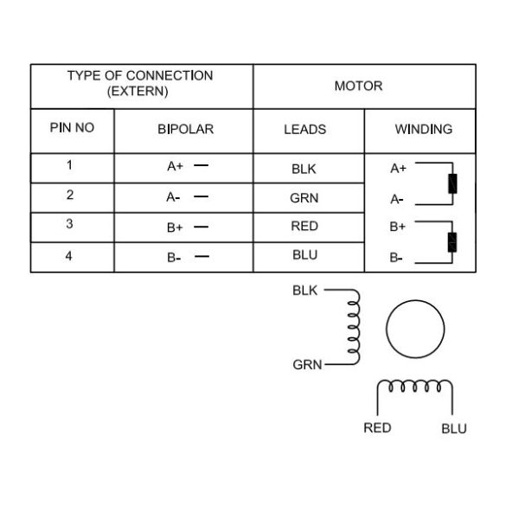
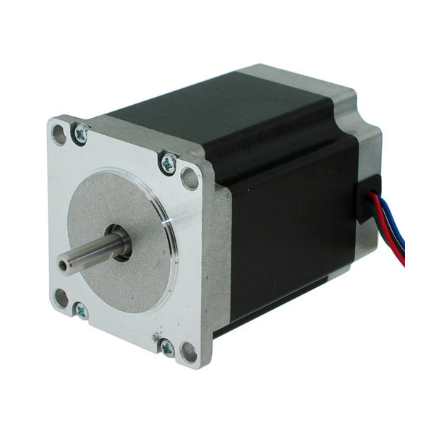
Stepper Motors
Moteur PAP 23HS30-2804S

Slide 3
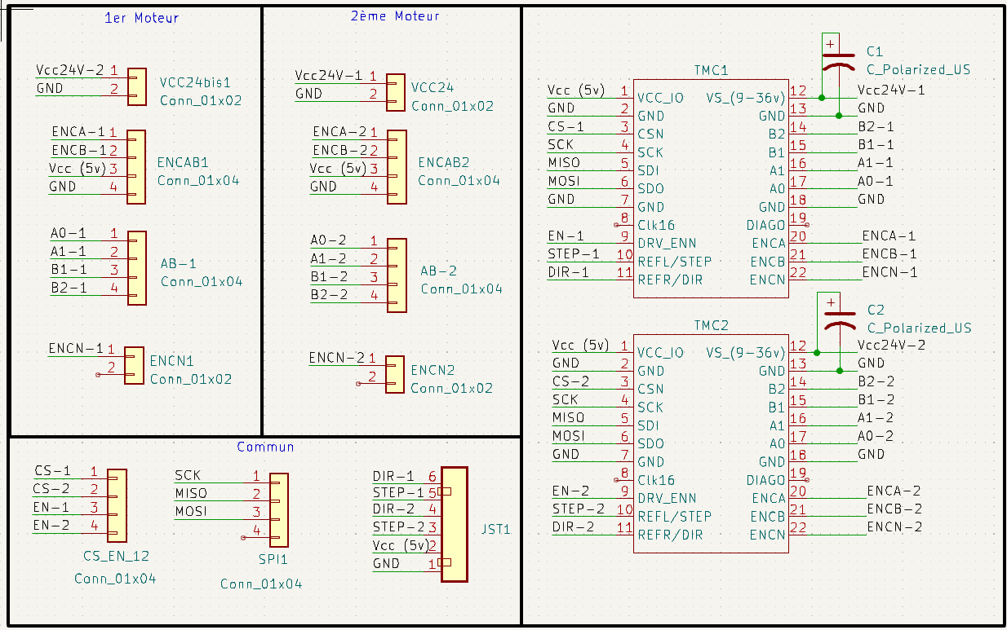
Driver boards

Slide 4
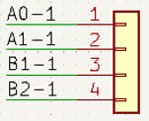
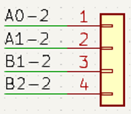
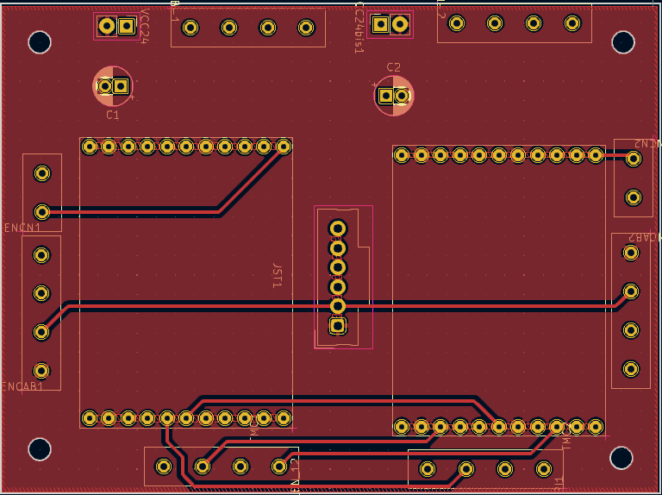


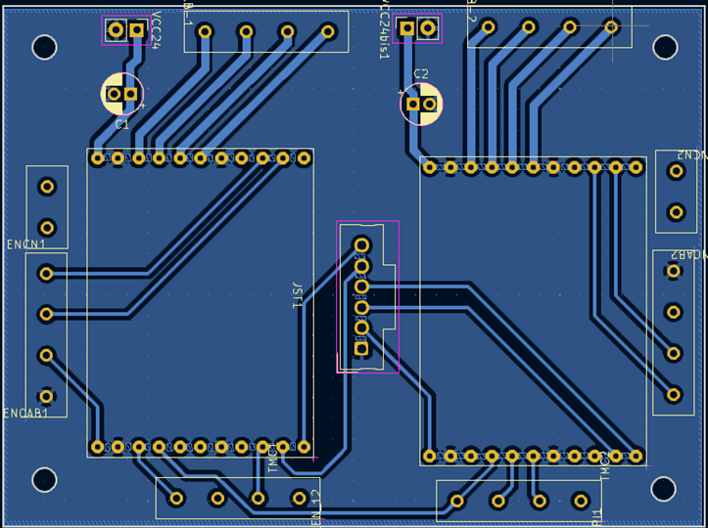
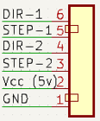
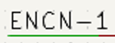

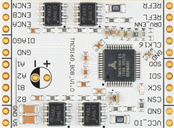



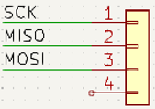
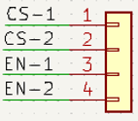
Driver boards
DRIVER 1
DRIVER 2

Slide 5
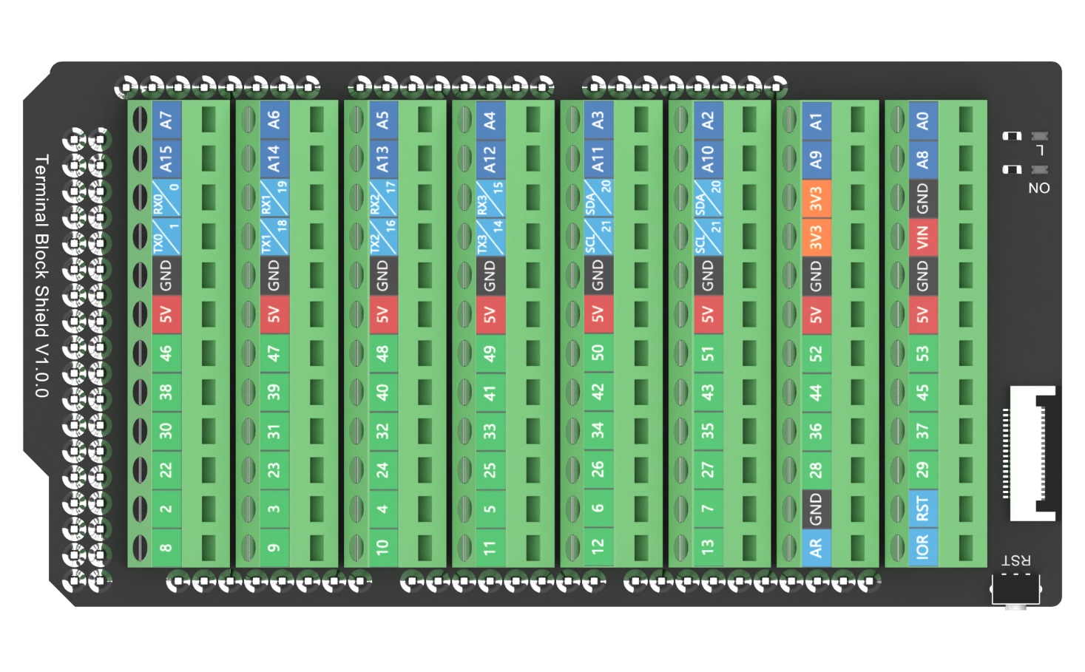
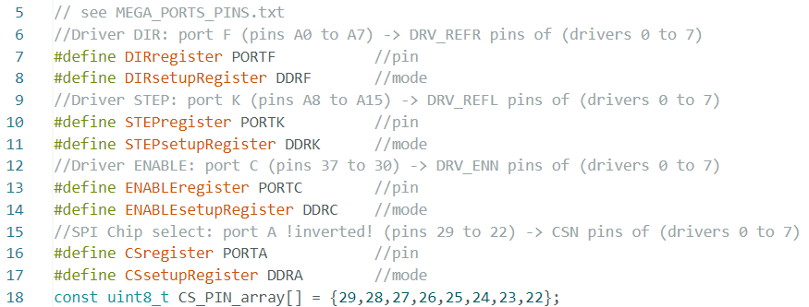
Arduino MEGA wiring
1
2
DIR:F
STEP:K
MISO
MOSI
SCK
EN:C
CS:A
DRV 7 _
DRV 6 _
DRV 5 _
DRV 4 _
DRV 3 _
DRV 2 _
DRV 1 _
DRV 0 _

